Slide 1
Introduction to FHIR
David Hay
September 15 , 2014

Slide 2
This presentation
Can be downloaded here:
http://gforge.hl7.org/svn/fhir/trunk/presentations/2014-09 Tutorials/Introduction to FHIR.pptx
Use “anonymous” and email address to logon
Is licensed for use under the Creative Commons, specifically:
Creative Commons Attribution 3.0 Unported License
(Do with it as you wish, so long as you give credit)

Slide 3
Who am I?
Name: David Hay
Company: Orion Healthcare
Background:
Trained as MD, been in Health IT 30 years
Ex Vendor (Ambulatory Care)
Co-chair FHIR Management Group
Chair HL7 New Zealand
FHIR Blogger (http://fhirblog.com)

Slide 4
Who are you?
What’s your background with HL7?
v2? v3? CDA? Brand new?
What’s your role?
Developer? Manager? Clinician? Other?
What’s the single most important thing for you to get out of today’s course?
Please be brief!

Slide 5
Tutorial Objectives
You should:
Know where FHIR fits in the broader healthcare landscape, including other HL7 specifications
Be able to explain what FHIR is to others in your organization, and what impact it might have
Be equipped to help your organization determine if, when, where and how you might use FHIR
Know how to approach the FHIR specification to find out what more you need to know
Be able to engage with the community
Notes:
9:15

Slide 6
What is FHIR?

Slide 7

Answer: An instigator of bad puns
FHIR is the hottest thing since . . .
This spec is spreading like wild. . .
Committee X is really on FHIR
Feel free to come up with your own
(but please, not here ☺)

Slide 8
The acronym
F – Fast (to design & to implement)
Relative – No technology can make integration as fast as we’d like
H – Health
That’s why we’re here
I – Interoperable
Ditto
R – Resources
Building blocks – more on these to follow
Notes:
9:25

Slide 9
Genesis of FHIR
Has been a need to share healthcare information electronically for a long time
Increasing pressure to broaden scope of sharing
Across organizations, disciplines, even borders
Mobile, Device & Cloud-based applications
Faster – integration in days or weeks, not months or years
Notes:
v2 is over 25 years old

Slide 10
Genesis of FHIR
Q: So what did HL7 have to offer in this space?
A: Not much
V2 Old, and limited by it’s own rules
V3 too slow and too hard
CDA has success, but both limited and too hard
Different contexts of interoperability → different representations that aren’t compatible
Nothing suitable for light-weight integration, or for Health 2.0

Slide 11

Genesis of FHIR
HL7 undertook a “Fresh look”
What would healthcare exchange look like if we started from scratch using modern approaches?
Web search for success markers led to RESTful based APIs
Exemplar: Highrise (https://github.com/37signals/highrise-api)
Drafted a healthcare exchange API based on this approach

Slide 12
FHIR Development Progress
July 2011 – Conception
Aug/Sept 2012 – First Draft Ballot
Sept 2012 – First Connectathon
Aug/Sept 2013 (now) – First DSTU ballot DSTU = Draft Standard For Trial Use
January 2014 – DSTU finalised
~May 2015 – 2nd DSTU
Mid 2016? – Normative Version

Slide 13
Timeline: Where does FHIR fit?
V2
1987
Start V3
1995
V3
CDA
2005
Fresh
Look
2011
FHIR
DSTU
2014
10 years
3
years
1980
1990
2000
2010
2020

Slide 14
FHIR Principles

Slide 15
FHIR Manifesto
Focus on Implementers
Target support for common scenarios
Leverage cross-industry web technologies
Require human readability as base level of interoperability
Make content freely available
Support multiple paradigms & architectures
Demonstrate best practice governance
Notes:
We don’t actually have a formal manifesto, but these are the principles we adhere to.

Slide 16
Implementer Focus
Specification is written for one target audience: implementers
Rationale, modeling approaches, etc. kept elsewhere
Multiple reference implementations from day 1
Publicly available test servers
Starter APIs published with spec
C#, Java, Pascal, ObjectiveC – more to come
Connectathons to verify specification approaches
Instances you can read and understand ☺
Lots of examples (and they’re valid too)
using HL7.Fhir.Instance.Model;
using HL7.Fhir.Instance.Parsers;
using HL7.Fhir.Instance.Support;
XmlReader xr = XmlReader.Create(
new StreamRead
IFhirReader r = new XmlFhirReader
// JsonTextReader jr = new JsonTe
// new StreamRead
// IFhirReader r = new JsonFhirRe
ErrorList errors = new ErrorList(
LabReport rep = (LabReport)Resour
Assert.IsTrue(errors.Count() == 0
Notes:
Who’s read the v3 spec? – modeler & balloter focused
Spec is driven by people who write code
Numerous pieces have been changed because of experience with what worked when trying to implement
Even have a test workbench for RESTful servers
External libraries already available
Whole spec is built like software project

Slide 17
Support “Common” Scenarios
Focus on scenarios implementers ask for
Inclusion of content in core specification is based on core content rule
“We only include data elements if we are confident that most normal implementations using that resource will make use of the element” (80%)
Other content in extensions (more on this later)
Easy to say, governance challenge to achieve
Resources are simple and easy to understand and use
Notes:
Design by constraint failed – years to develop, what was produced required yet more design to be implementable and after that might not be interoperable
How to determine the 80%? Look to existing specs – v2, v3, CDA templates, OpenEHR, jurisdictional projects, what implementations we’ve seen
If not sure, err on the side of “not in for now”
Note: not 80% of instances, 80% of implementations
Challenges with “raising the bar”
What happens when there aren’t many/any implementations?

Slide 18
Web technologies
Instances shared using XML or JSON
Collections represented using ATOM
Same technology that gives you your daily news summary
Out-of-the-box publish/subscribe
JSON representation as well
Web calls work the same way they do for Google, Facebook & Twitter
Rely on HTTPS, OAuth, etc. for security functions
Notes:
We try very hard to *not* invent stuff that exists elsewhere unless it’s really broken or totally unaligned with the FHIR principles.

Slide 19

Human Readable
CDA has both narrative and data
The data / narrative dynamic exists throughout the process
In FHIR, every resource should have a human-readable expression
Can be direct rendering or human entered
Notes:
Even when you think your target will understand all the encoded data, reality is data often gets shared beyond the originally intended context
Allow for exceptions for things like automated device readings, etc.

Slide 20
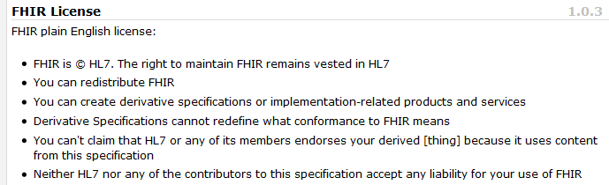
Freely available
Unencumbered – free for use, no membership required
http://hl7.org/fhir
Notes:
Was a bigger deal before HL7 decided to open up all IP
full legal text towards bottom of FHIR home page

Slide 21
FHIR & Cost of Integration
These factors will drive down the cost of integration and interoperability
Easier to Develop
Easier to Troubleshoot
Easier to Leverage in production
More people to do the work (less expensive consultants)
Competing approaches will have to match the cost, or disappear – effect is already being felt

Slide 22
Future impact of FHIR
Impact of FHIR on the market:
Drive interoperability prices down
Higher Expectations
Sense of a community
Overall Market focus
PHR on the web
Healthcare repositories (MHD+)
Device Data management
Retooling existing connections
Notes:
How much integration do you need? Nx2 – twice what you have

Slide 23
Paradigms and Architectures
Notes:
9:45

Slide 24
Paradigms
FHIR supports 4 interoperability paradigms
REST
Documents
Messages
Services

Slide 25
REST
“Representational state transfer” – an architecture for how to connect systems
CRUD
Outcomes
Simple stable interfaces
High Performance / Scalability
Visible Process (e.g. can debug)
Portability
Reliability (resistance to failure)

Slide 26
Document
Atom
Similar to CDA
Collection of resources bound together
Root is a “Composition” resource
Just like CDA header
Sent as an ATOM feed
One context
Can be signed, authenticated, etc.
Composition
Resource 1
Resource 2

Slide 27
Message
Similar to v2 and v3 messaging
Also a collection of resources as an ATOM feed
Allows request/response behavior with bundles for both request and response
Event-driven
E.g. Send lab order, get back result
Can be asynchronous
Atom
MessageHeader
Resource 1
Resource 2
Notes:
10:30

Slide 28
Service Oriented Architecture (SOA)
Do whatever you like
(based on SOA principles)
Ultra complex workflows
Ultra simple workflows
Individual resources or collections (in Atom or other formats)
Use HTTP/S or use something else
Only constraint is that you’re passing around FHIR resources in some shape or manner
Services
Notes:
Comment about SOA discovery day

Slide 29

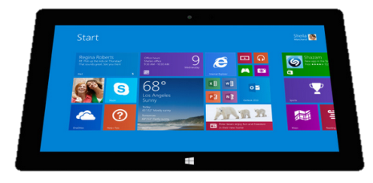
Regardless of paradigm
the content is the same
Receive a lab result in a message…
FHIR
Repository
FHIR Message
FHIR Document
Lab System
REST
National
Exchange
…Package it in a discharge summary document

Slide 30
Architectures
FHIR makes no assumptions about the architectural design of systems
You can use it for
Light or heavy clients
Central server or peer-to-peer sharing
Push or pull
Query or publish/subscribe
Loosely coupled or tightly coupled environments
With history tracking (versions) or without
Notes:
More on this later…

Slide 31
Some possibilities
v3
App
v2
FHIR
PHR
FHIR
Broker
Comm.
Interface
FHIR
DB
Notes:
You’re a message broker routing and translating between v2, v3 and FHIR
Your app interfaces with a PHR using FHIR natively
Your application can communicate using FHIR, but your software uses a proprietary RDBMS
Use FHIR as the common language for a Vendor Neutral Archive
…Or a combination….
You might see data as a nested structure of XML, a series of tables with keys, class-diagrams….

Slide 32
Reading the FHIR Spec

Slide 33
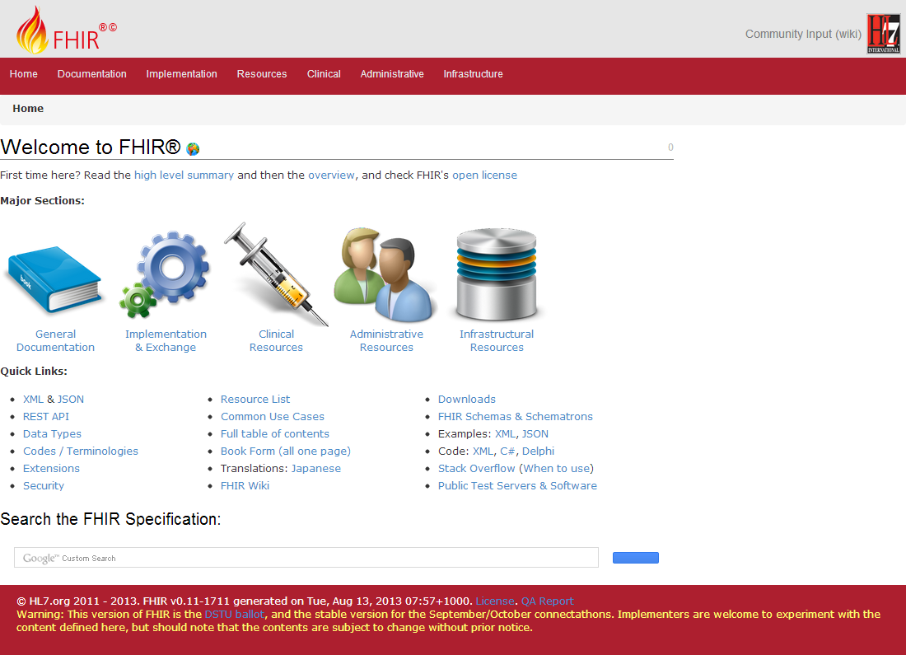
(FHIR home)
hl7.org/fhir
Notes:
Published as HTML
Published using validation process that performs consistency checks – like a software build
Really shouldn’t require much guidance to read, but a few things to call out
Objective of spec is developer can skim and decide in < day

Slide 34
FHIR Resources
Notes:
10:00

Slide 35

Resources
“Resources” are:
Small logically discrete units of exchange
Defined behaviour and meaning
Known identity / location
Smallest unit of transaction “of interest” to healthcare
V2: Sort of like Segments
V3: Sort of like CMETs

Slide 36
What’s a Resource?
Examples
Non-examples
Administrative
Patient, Practitioner, Organization, Location, Coverage, Invoice
Clinical Concepts
Allergy, Condition, Family History, Care Plan
Infrastructure
Document, Message, Profile, Conformance
Gender
Too small
Electronic Health Record
Too big
Blood Pressure
Too specific
Intervention
Too broad
100-150 total
Notes:
And few systems will ever see more than 40-50

Slide 37
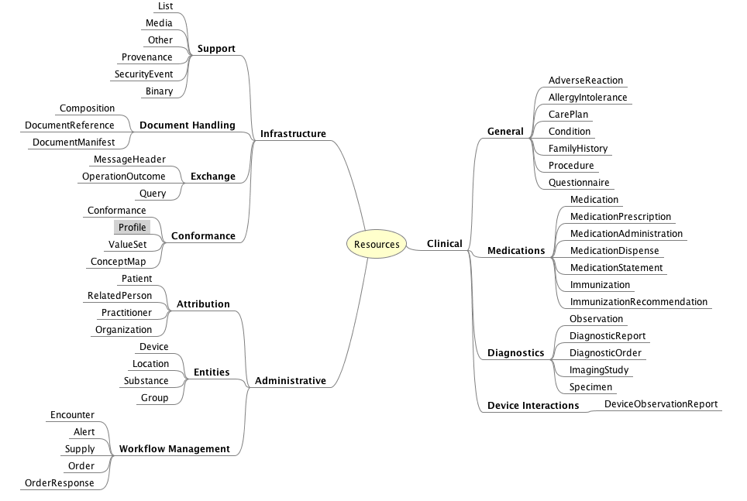
DSTU Resource List

Slide 38
Resource anatomy
Resources have 3 parts
Extensions
Narrative
Defined
Structured
Data
Notes:
Defined Structured Data
The logical, common contents of the resource
Mapped to formal definitions/RIM & other formats
Extensions
“Non-common” requirements, but everyone can use
Published and managed
Narrative
Human readable (fall back)

Slide 39
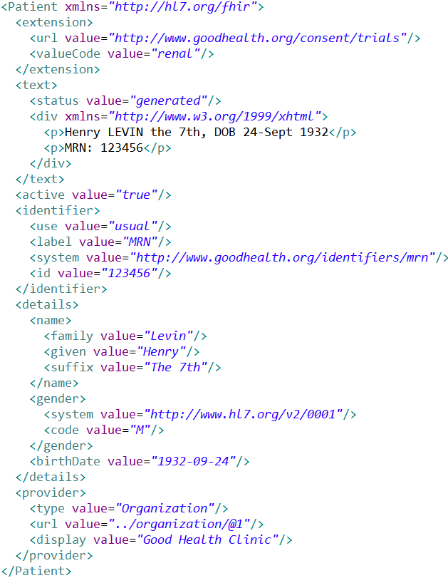
Extension with reference to its definition
Human Readable Summary
Standard Data Content:
MRN
Name
Gender
Date of Birth
Provider
Notes:
System for gender is wrong . . .

Slide 40

Structure of a Resource
Metadata
Resource
Narrative
Elements
Extensions
Extensions

Slide 41
Resource Documentation
For each Resource:
Scope and Usage Notes
Resource Content (UML and XML)
Terminology Bindings
Constraints
Implementation Issues
Search Parameters
Examples, Profiles, Formal Definitions
Mappings to RIM, CDA, v2, etc

Slide 42
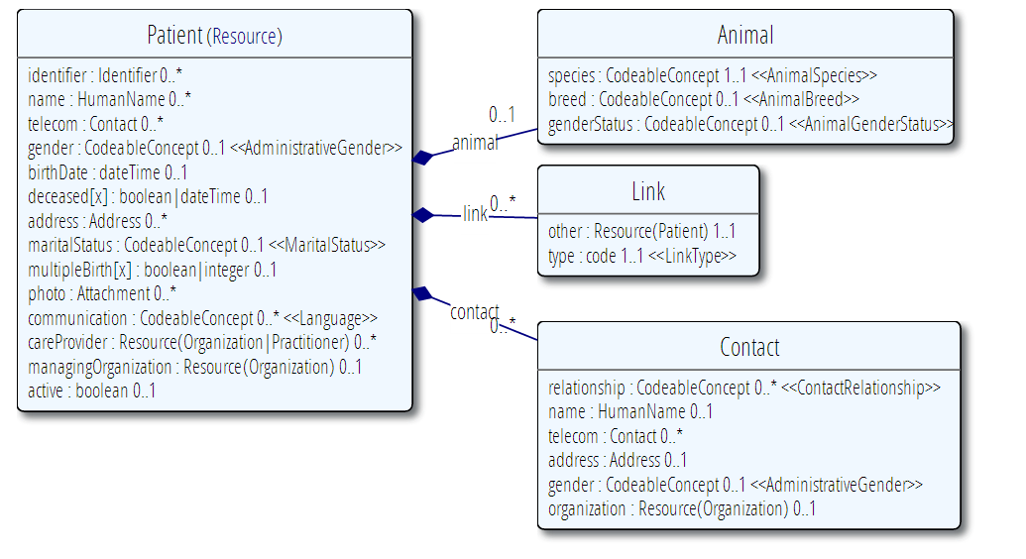
Example Resource Definitions

Slide 43
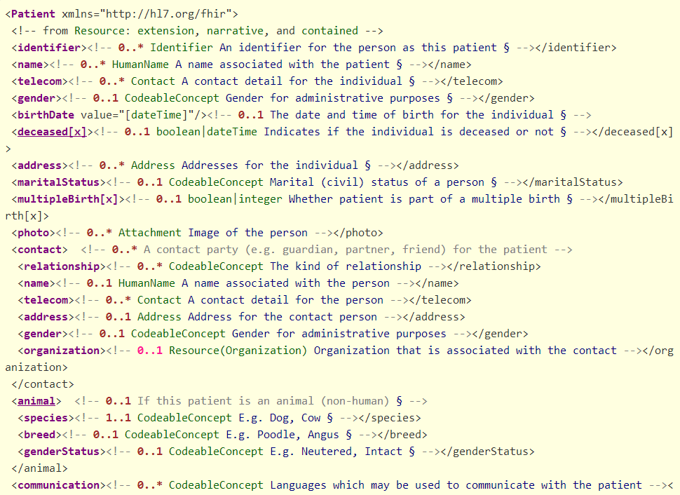

Slide 44
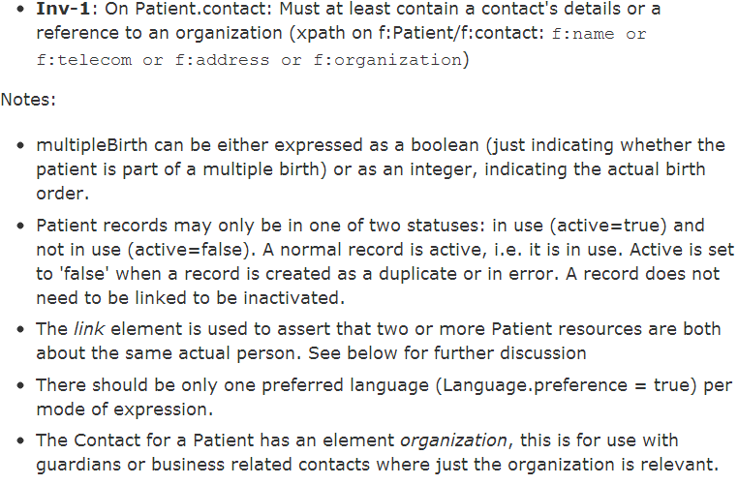
Constraints & Notes

Slide 45
Resource elements
Resources are defined as an XML structure based on desired wire syntax
Hierarchy of elements
Each element has
Name
Either a datatype or nested elements
Cardinality
All collections are nested in a containing element
Definition
Mappings
But instances in XML or JSON

Slide 46
It’s all about combining resources . . .
http://lab.hospitalA.org/Observation/3ff27
http://moh.govt.nz/nhi/Patient/223
Observation
Patient
Diagnostic
Report
Organization
http://lab.hospitalA.org/DiagRep/4445
Practitioner
http://moh.govt.nz/hpi/Organization/1
http://moh.govt.nz/hpi/Practitioner/87

Slide 47
References
Resources are independent – don’t need to other resources to correctly interpret a resource
But resources reference each other extensively to form a web of information
Need to resolve references to fully understand the data
<Procedure xmlns="http://hl7.org/fhir">
<subject>
<reference value="Patient/23"/>
</subject>
…
<report>
<reference value=”http://myServer/DiagnosticReport/45"/>
</report>
…

Slide 48
Rules for references
References can be relative or absolute
References don’t have to be to the same server
Server does not have to enforce integrity
Clients need to cater for broken links
Targets can be ‘contained’ in the resource:
<Procedure xmlns="http://hl7.org/fhir">
<contained>
<Patient id="pat">
</Patient>
</contained>
<subject>
<reference value="#pat"/>
</subject>

Slide 49
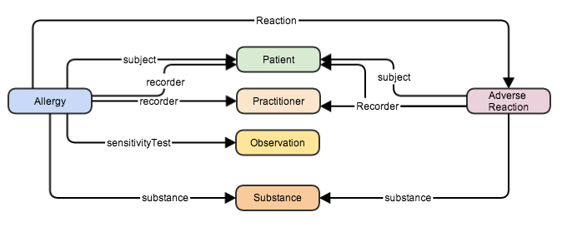
References between resources

Slide 50
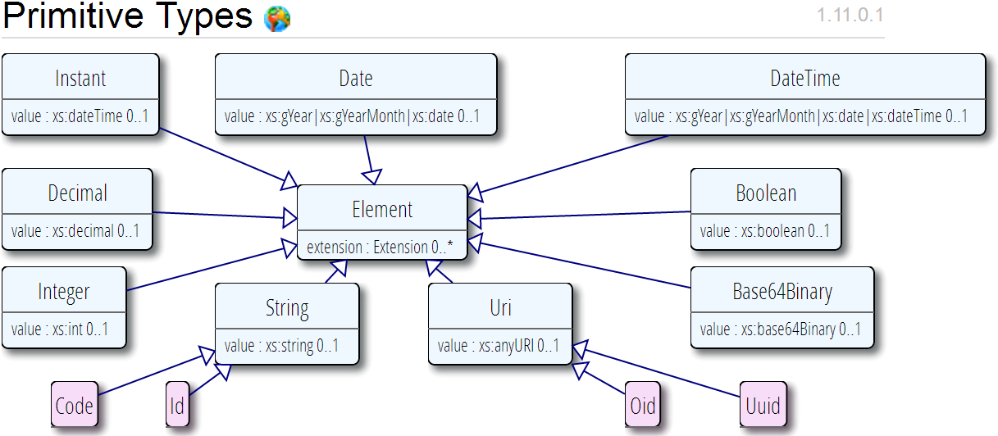
Data types
Based on w3c schema and ISO data types
Stick to the “80% rule” – only expose what most will use
Simplified

Slide 51
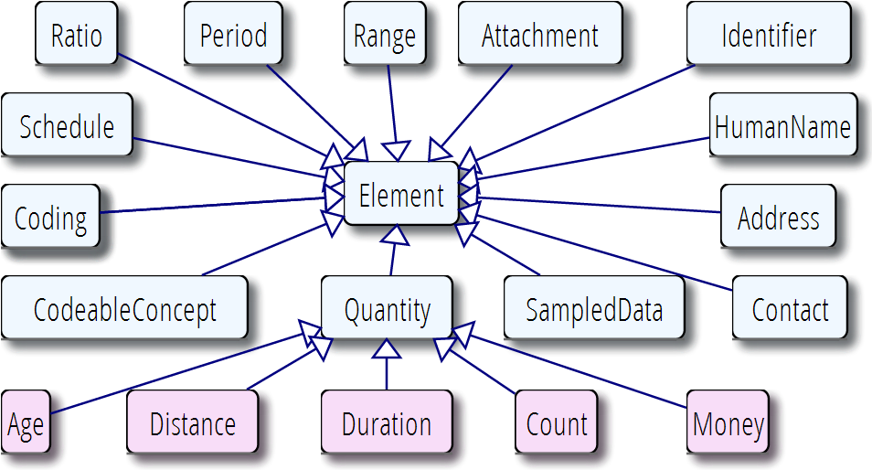
Data types (cont’d)

Slide 52
Example – CD datatype
ISO
Code, code system, code system name, code system version, value set id, value set version, coding rationale, updateMode, flavorId, nullFlavor, controlAct root & extension, validTime low and high
displayName with language and translations
originalText with mediaType, language, compression, integrityCheck, thumbnail, description, translations, reference (can be text, video, whatever)
Translations (most of same info as code)
Source code

Slide 53
Example – CD datatype
FHIR
Code, code system, code system name, code system version, value set id, value set version coding rationale, updateMode, flavorId, nullFlavor, controlAct root & extension, validTime low and high
displayName with language and translations
originalText with mediaType, language, compression, integrityCheck, thumbnail, description, translations, reference (can be text, video, whatever)
Translations (most of same info as code)
Source code

Slide 54

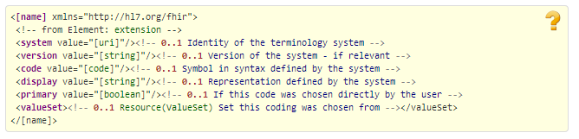
CodeableConcept
CodeableConcept
Coding

Slide 55
Vocabulary
Support for coded data of varying complexity
Some codes defined as part of resource, others referenced from external vocabularies
LOINC, SNOMED, UCUM, etc.
Recognition some will differ by implementation space
Can use Value Set resource to define more complex or specific code lists

Slide 56
Narrative
All resources can carry an html representation of their content
It’s a clinical safety issue
The receiver has a fall back option if the system is not sure it fully understands the content
It is not mandatory, but SHOULD be present
In a closed eco-system, with extremely tight control and strong conformance testing, it may not be necessary
But things often change over time
So using narrative is highly recommended
Notes:
Saves a lot of money downstream from the author

Slide 57
Narrative XHTML
Narrative is XHTML. Formatting allowed:
Tables, lists, divs, spans
Bold, Italics, styles etc
E.g. all static content
Features not allowed:
Objects, scripts, forms – any active content
Links, Stylesheets, iframes – web context
Local storage, Microdata (no active content)
Concerns are security and clinical safety

Slide 58
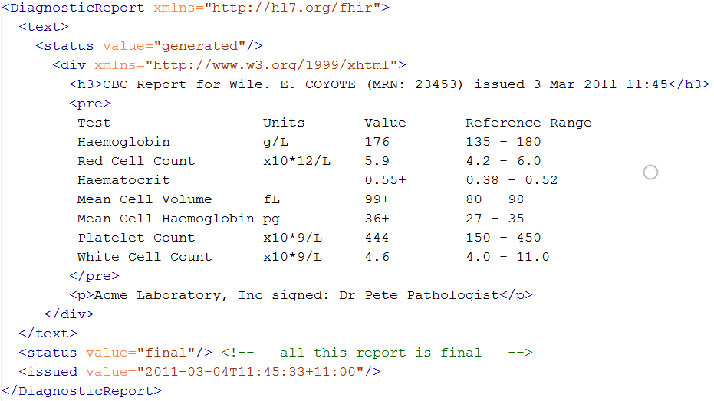
Narrative example
Notes:
Resources SHOULD always contain narrative to support human-consumption as a fallback. However, in a strictly managed trading systems where all systems share a common data model and additional text is unnecessary or even a clinical safety risk, the narrative may be omitted.
generated The contents of the narrative are entirely generated from the structured data in the resource.
extensions The contents of the narrative are entirely generated from the structured data in the resource and some of the content is generated from extensions.
additional The contents of the narrative contain additional information not found in the structured data.
empty the contents of the narrative are some equivalent of "No human-readable text provided for this resource".

Slide 59
FHIR Extensions
Notes:
10:15

Slide 60
The Case for Extensions
Extensions are often problematic in existing HL7 specs
Z-segments in v2
What does this mean?
ZSB|20080117|Q^57|4.30^uL
Foreign namespaces in CDA/V3
Break schemas
Simple choice – design for absolutely everything or allow extensions

Slide 61
Extensions
FHIR has a standard framework for extensions
Built into wire format
Every FHIR element can be extended
Including datatypes
Every extension has:
Reference to a computable definition
Value – from a set of known types
Every system can read, write, store and exchange all legal extensions
All extensions are valid by schema etc.

Slide 62
Extensions
In FHIR, extensions are “normal”
Consequence of the 80% rule – keep the simple stuff simple
Extensions can exist anywhere
Yes, even inside boolean or date
Conformant systems can’t reject instances just because they contain unrecognized extensions
They could:
Display them
Should be in resource narrative
Store as a ‘Blob’
Make a conscious decision to ignore (unless ModifierExtension)
(Could lookup profile)
Notes:
[31/08/14 3:34:55 pm] Lloyd McKenzie: no. They can't refuse the instance because it contains extensions (unless they're modifierExtensions), but they're free to strip/ignore them.
[31/08/14 3:35:19 pm] Lloyd McKenzie: Requiring persistance would cause havoc with legacy systems

Slide 63
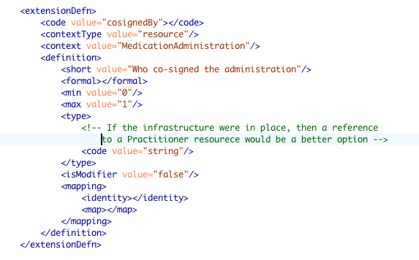
Extension definition

Slide 64
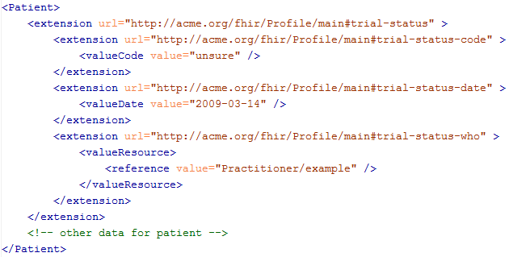
An Extension in a resource

Slide 65
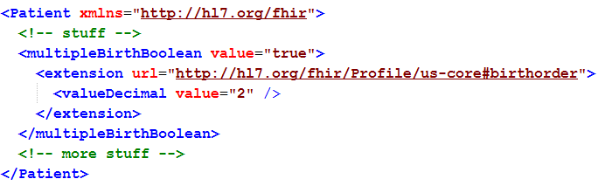
Extending a multiple birth
Key = location of formal definition
Value = value according to definition
Notes:
Really any FHIR element (Resource, Datatype, Primitive) can be extended. Just nest an <extension> element under the thing you want to extend
You should be able to go to the formal definition endpoint and get the definition of the extension.
Note: birth order is already provided for in FHIR through the multipleBirthInteger

Slide 66
Modifier Extensions
Also a core part of FHIR
Needed because some extensions can’t be safely ignored
Can’t compute on an element containing an unrecognized modifier extension. However, can:
Reject instance
Just display narrative
Retrieve definition & seek human review

Slide 67
Modifier Extension decisions
When should you introduce them?
modifierExtension breaks interoperability so:
If you can accomplish your objective without one, do that
Consider a new resource or Other resource
Could requirement be met by an element that doesn’t change other element interpretations?
Best used when already part of existing practice, but in too narrow an area to justify being part of core

Slide 68
Governing Extensions
Extensions are not a silver bullet
FHIR has a sliding scale governance for extensions
HL7 published extensions
National Standards (e.g. Standard Finnish Extensions)
Domain standards (e.g. Best Practice Cardiology)
Local Projects

Slide 69
resource misc.
Notes:
10:15

Slide 70
Tags
Contain metadata about resources
Beyond ID, version & date
Used for different purposes:
Compliance to Profile
Security – e.g. sensitivity of resource
Indicate Document/Message
User defined
Transported in different ways:
REST – as an HTTP header
In a bundle (document, message, transaction) - in the feed.category element

Slide 71
Versioning
Most recent version
http://server.org/fhir/Patient/1
Returns single resource
All versions
http://server.org/fhir/Patient/1/_history
Returns bundle of versions
Specific version
http://server.org/fhir/Patient/1/_history/_1
Returns single resource
Version support is optional
Notes:
Works at instance and type level – originally there

Slide 72
Bundles
When more than one resource needed
Query result
Document
Message
Atom ‘feed’
With JSON representation

Slide 73
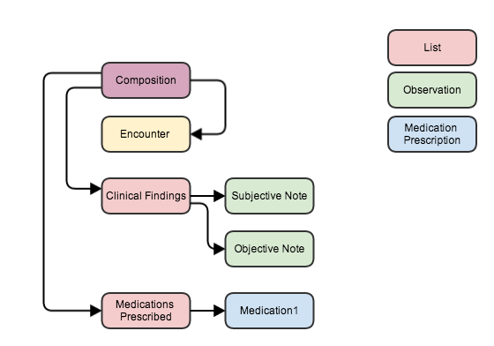
Bundle as a serialized Object Graph
Notes:
Imagine that all resources in a single bundle
Links maintain references
Comment on new recources (cid: id’s)

Slide 74
About REST and Resources
Notes:
Because REST was the biggest need and the most currently worked out…

Slide 75
REST in practice
“Resources” with an explicit and stable URI
The name for what gets exchanged in REST
Defined behaviour and meaning
Known identity / location
Quite an abstract idea
Formats: XML / JSON / RDF
Exchange using HTTP
Security: SSL / OAuth
“REST” followed loosely, hence “RESTful”

Slide 76
REST Operations
CRUD:
Create – create a new instance of data
Read – get the content (state) of an instance of data
Update – change the content of an instance of data
Delete – remove the instance of data
Notes:
Delete isn’t necessarily physical
Execute – eg transaction

Slide 77
RPC vs REST
RPC (Remote Procedure Call):
Ask a server to perform some operation
Hand it a set of parameters
Server performs some operations
Returns a set of parameters
REST:
Define a URI that represents the state of something
Tell the server what the state should be
Server makes the state change happen

Slide 78
RPC vs REST example
Example:
A device that monitors a patient %0₂ Sat
Raises an alarm on EHR if it’s too low
EHR can turn the alarm off
RPC:
POST http://acme.org/devices/turnOffAlarm
Parameters: device id, alarm id
REST:
POST http://acme.org/devices/[deviceid]/[alarmid]
Content: data to say “Alarm is off”

Slide 79
RPC vs REST
Difference is subtle, and depends on perspective
Outcome is large difference
REST is increasingly preferred in practice
Most systems mix and match
“mini-operations”
General issue: REST doesn’t deal well if server needs context from the client
Needed for poorly trusted clients

Slide 80
FHIR Operations
(Based on REST)

Slide 81
Business Operations
Register a patient:
Create a Patient Resource
Admit a patient:
Create an Encounter Resource
Move a patient from one bed to another
Find and update the encounter resource
Prepare a list of medications to administer
Search through the medication prescriptions for a patient (and then apply logic)
Or, use a List resource

Slide 82
FHIR Resource URLs
Template | Description | Example
[base] | Server URL | http://fhir.com
[base]/[type] | URL for type manager | http://fhir.com/Patient
[base]/[type]/[id] | URL for a resource | http://fhir.com/Patient/23
[base]/[type]/[id]/_history/[vid] | URL for a past version of a resource | http://fhir.com/Patient/23/_histroy/2

Slide 83
Operations / Instance
Op | Description | Request Content | Response Content
read | Read the current state of the resource | -- | Resource
vread | Read the state of a specific version of the resource (e.g. what it was in the past) | -- | Resource
update | Update an existing resource by its id (or create it if it is new). Use the resource representation supplied | Resource | --
delete | Remove the resource so it is no longer present (note: it still has a history) | -- | --
history | Get a list of all the past versions of the resource | -- | Atom feed

Slide 84
Operations / Type
Op | Description | Request Content | Response Content
create | Create a new resource with a server assigned id | Resource | --
search | Search through all resources of the type based on some filter criteria | Params | Atom Feed
history | Get a list of all the past versions of this resource type | -- | Atom Feed
validate | Check that the content would be acceptable as an update | Resource | Resource (OperationOutcome)

Slide 85
Operations / System
Op | Description | Request Content | Response Content
conformance | Get a conformance statement for the system | -- | Resource
transaction | Update, create or delete a set of resources as a single transaction | Atom Feed | Atom Feed
history | Retrieve the update history for all resources (full pub/sub) | -- | Atom Feed
search | Search through all resources of all types based on some filter criteria | Params | Atom Feeds

Slide 86
Playing with FHIR
Access public server
Notes:
Sample CRUD stuff
Search for patient on name
Specify json or xml
Get a patient
Update a patient
Grahames & Ewouts server

Slide 87
Profiles & conformance
Notes:
10:15

Slide 88
Profiles
Document constraints and extensions on one or more resources for a Use Case
May also define new extensions search terms, new messaging events, etc.
Subsumes: template, implementation profile, DCM (Detailed Clinical Model), etc.
Looks an awful lot like the definition of the resources themselves
You can download profile XML for all resources
Notes:
Extensions and profiles are a big part of spec – Wednesday Q2 for specific session

Slide 89
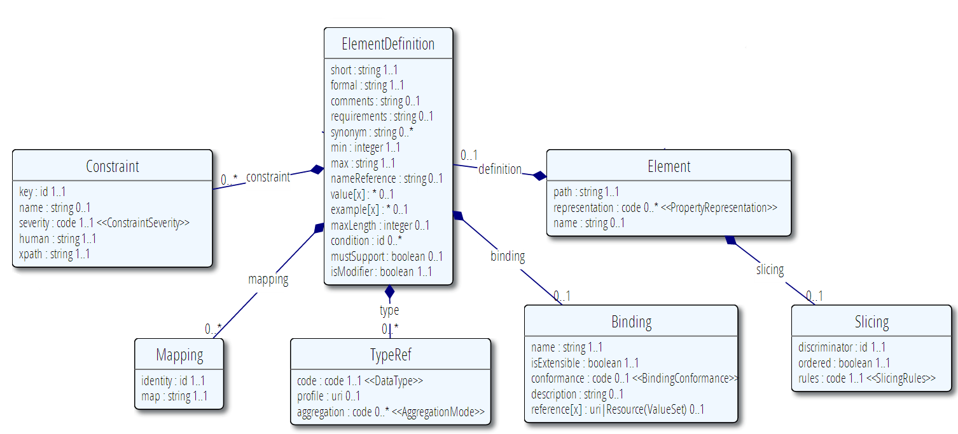
Profile (cont’d)

Slide 90
Using Profiles
You can just go ahead and use a resource
No need for a profile
But you should write a profile
Document your usage in detail for partners
You can mark a resource or bundle with a profile
It’s just a claim – can test conformance with that
Notes:
Denormalization for performance
Comment that profiles will be really important

Slide 91
Conformance
There’s a resource for documenting conformance to FHIR
Can be used for:
Stating how a specific system instance behaves
Defining how a software system is capable of behaving (including configuration options)
Identifying a desired set of behavior (e.g. RFP)
To declare themselves “FHIR Conformant”, a system must publish a Conformance instance
Notes:
Doesn’t have to support XML – is can be json only

Slide 92
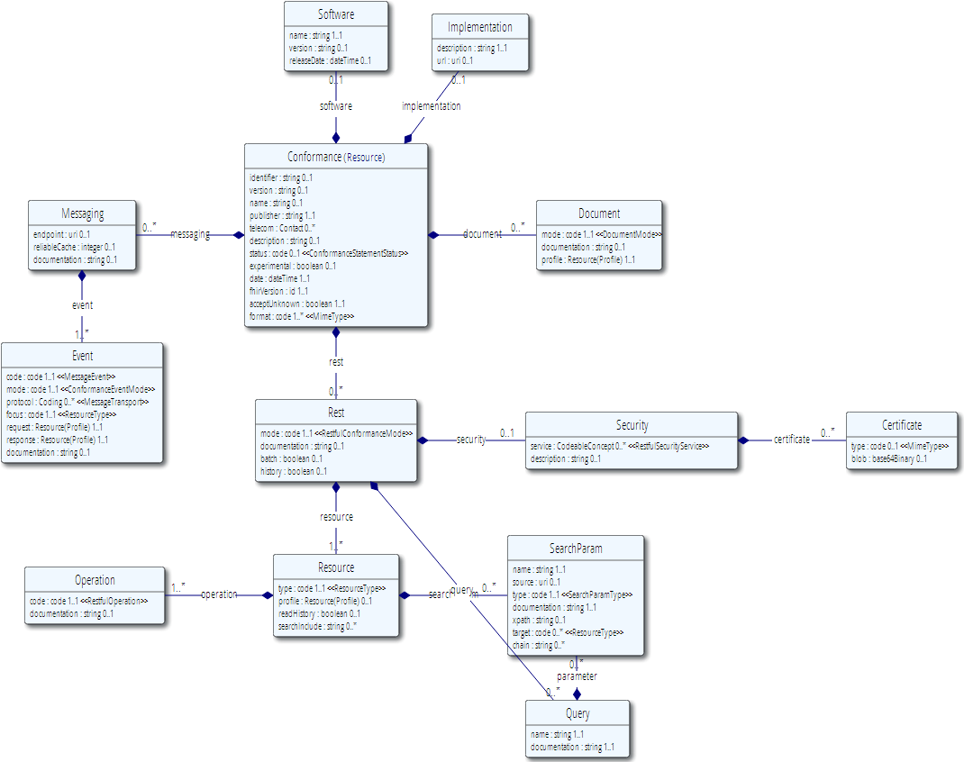
Conformance (cont’d)

Slide 93
Implementing FHIR

Slide 94
Where can FHIR be used?
Classic in-institution interoperability
Back-end e-business systems (e.g. financial)
Regional Health Information Organizations (RHIO)
National EHR systems
Social Web (Health)
Mobile Applications
Near
Term

Slide 95
Architecture
Standalone FHIR Server
A FHIR Server in front of an existing application (e.g. SQL)
FHIR as front end to an XDS server (“MHD”)
An interface engine that ‘speaks’ FHIR
A tablet/mobile phone application
Web portal uses FHIR to access other systems
A healthcare application that access information from multiple systems as well as it’s own server
Smart-On-FHIR – an EHR plug-in framework

Slide 96
Implementation Assistance
Reference Implementations – object models, parsers, serializers, clients, validators, utilities
Schema, Schematron, Validation Pack
1000’s of examples
Live Servers to test against
http://wiki.hl7.org/index.php?title=Publicly_Available_FHIR_Servers_for_testing
Connectathons

Slide 97
Servers
Use the servers to explore how it works
Write clients that use the test data
Test that you got your own system right
Most developers:
Use the servers to learn
Consult the documentation occasionally
We do recommend to read the specification
(RTFS)

Slide 98
Other Free software
See http://wiki.hl7.org/index.php?title=Open_Source_FHIR_implementations
Coming shortly:
“Sprinkler” – a conformance test tool for servers
“Forge” – an editor for conformance statements
A Value set Editor
Several implementation guide publishers

Slide 99
Connectathons
Open invitation to any interested party to come and write software that exchanges FHIR resources
Always hold one before HL7 meetings (last week) + Others by invitation
Mix of skills
Newbies (“where is the spec?”)
Old hands who’ve been to every connectathon
Experiment with new features
We have a virtual connectathon all the time…

Slide 100
Implementation Assistance
Stack Overflow – ask implementation questions
Link from front page
Search for answers first
Don’t ask for changes to the spec (get deleted!)
gForge Tracker – ask for changes to the spec
Link from bottom of every page
But have discussion somewhere first
Disqus – on every page of the specification
Skype – implementers channel – 105 participants
FHIR Email list, Connectathons, Tutorials

Slide 101
Migration
No expectation that people will migrate existing interfaces any time soon.
Initial adopters will be green-field, new technology
FHIR may see use behind the scenes in v2 systems before it sees use over the wire
Forthcoming policy initiatives may necessitate revisiting existing interfaces

Slide 102
Migration – v2
Already have an integration engine that supports translation between v2 and FHIR
Resources map to segments reasonably well
As always, the challenge with v2 mapping is the variability of v2 interfaces
“Common” mappings can be created, but they won’t be one size fits all

Slide 103
Migration – CDA
Made more complex by human-readable nature
Need to ensure text <-> entry linkages are retained
Will best be handled on a template by template basis
Likely start with important ones like C-CDA
Notes:
12:15
Text linkages not as important when not human-attested

Slide 104
What’s next?

Slide 105
Development plans
Performing rigorous QA on initial set of resources
Full support for C-CDA in next DSTU
Additional resources will continue to be introduced in future DSTU cycles as implementers identify needs
Continue to seek testing & real world implementation experience

Slide 106
Balloting plans
First Draft Standard for Trial Use ballot (DSTU) complete
DSTU publication in Jan 2014
Will provide a semi-stable platform for implementers while still allowing non-backward-compatible change for Normative version if implementation experience dictates
Additional DSTU versions roughly annually to make fixes, introduce new resources
Normative is around 3 years out
We want *lots* of implementation experience before committing to backward compatibility

Slide 107

Next Steps for you
Attend the other FHIR tutorials
Architects, Developers, Profiles
Read the spec: http://hl7.org/fhir
Comment on the wiki (link from FHIR spec)
Follow #FHIR on Twitter
Shape the specification:
Join the FHIR track at this WGM
Join the FHIR email list http://wiki.hl7.org/index.php?title=FHIR_email_list_subscription_instructions
Try implementing it
Make Ballot comments
Come to a Connectathon!

Slide 108






International HL7 FHIR Developer Days November 24-26, 2014 in Amsterdam
Education
14 tutorials
pick & choose
Connectathon
Meet fellow developers
Put FHIR to the test
Networking
FHIR experts and authors on hand
http://fhir.furore.com/devdays

Slide 109
Review

Slide 110
What does FHIR provide?
Resources (building blocks)
Extensions
Methodology
Versioning, Bundles, Profiles, Conformance
Syntax (XML, JSON)
Human readability
Support for multiple Paradigms
REST, Messaging, Documents, Services

Slide 111
FHIR Manifesto
Focus on Implementers
Target support for common scenarios
Leverage cross-industry web technologies
Require human readability as base level of interoperability
Make content freely available
Support multiple paradigms & architectures
Demonstrate best practice governance

Slide 112
FHIR & Cost of Integration
These factors will drive down the cost of integration and interoperability
Easier to Develop
Easier to Troubleshoot
Easier to Leverage in production
More people to do the work (less expensive consultants)
Competing approaches will have to match the cost, or disappear – effect is already being felt

Slide 113
Future impact of FHIR
Impact of FHIR on the market:
Drive interoperability prices down
Higher Expectations
Sense of a community
Overall Market focus
PHR on the web
Healthcare repositories (MHD+)
Device Data management
Retooling existing connections
Notes:
How much integration do you need? Nx2 – twice what you have

Slide 114

Questions?
http://hl7.org/fhir
http://wiki.hl7.org/index.php?title=FHIR

